Slide 1
HOTEL BOOKINGS ANALYZING DATA
Created by : Anshi singh

Slide 2
Project Overview
In this project, we embarked on a comprehensive analysis of hotel booking data using Python. The dataset, which was loaded and processed, underwent several crucial stages, including data cleaning and analysis. Here is an overview of our project's key components:
1. Data Loading and Preprocessing
Duplicate Removal
Handling Missing Values
Cancellation Bookings
2. Guest Home Town Country
3. Market Segment Analysis
4. Guest Arrival Distribution

Slide 3
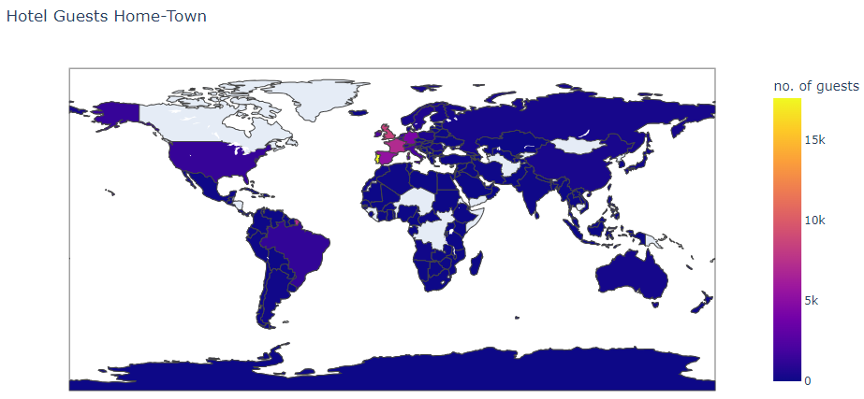
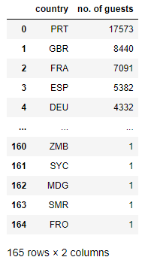
This Choropleth map provides a comprehensive depiction of the primary countries of origin for hotel guests, revealing a predominant concentration from European nations.
Spatial Analysis on Guests Home-Town

Slide 4
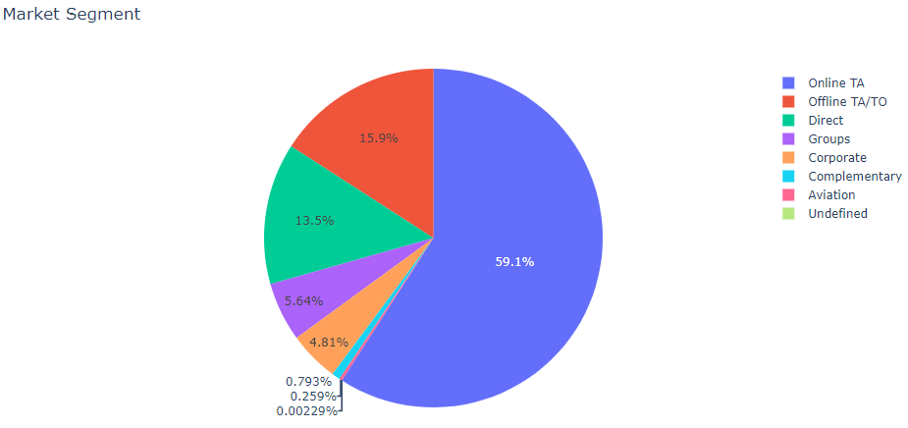
Analyzing the market segment with the highest booking rates, our findings are illustrated in the pie chart. Notably, nearly 60% of the bookings were facilitated through online channels, while offline and direct bookings are close enough. Only 10% of bookings are through other channels.
Market Segment with highest bookings

Slide 5
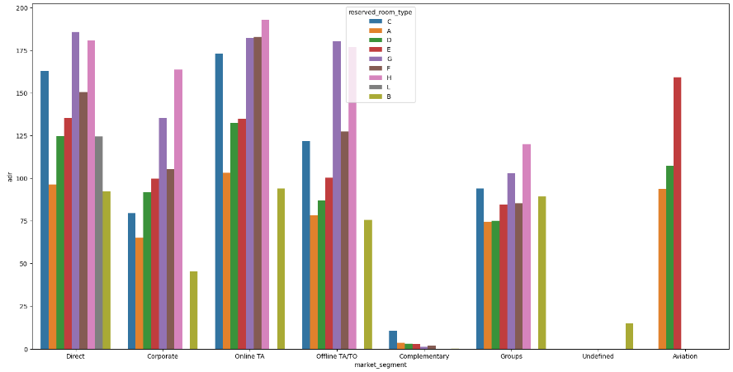
In the chart presented, the vertical axis represents the Average Daily Rate (ADR), while the horizontal axis denotes the Market Segment. Notably, across all market segments, it is evident that room types G and H consistently exhibit a notably higher Average Daily Rate (ADR).
Avg daily rate (ADR) of hotel rooms for all market segment

Slide 6
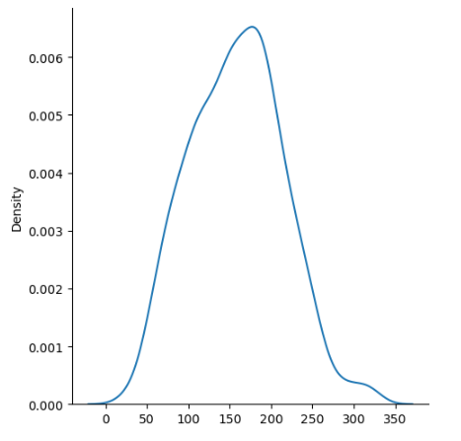
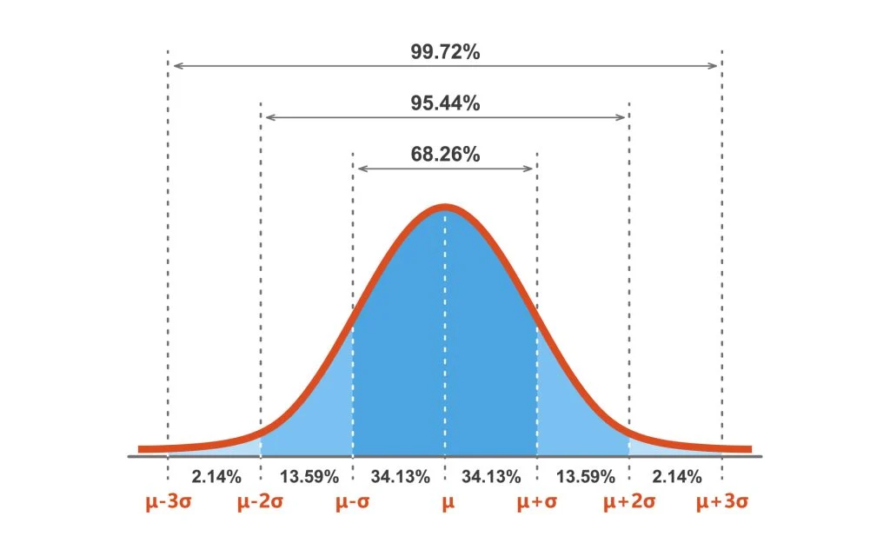
This dataset exhibits a Normal Distribution. Our calculations reveal insightful ranges: * Approximately 68% of guest arrivals are expected to fall within the interval of 101 to 214. * A broader range, spanning from 45 to 270, will encompass approximately 95% of guest arrivals. * An even wider range, ranging from 0 to 327, will encompass the arrivals of approximately 99% of guests.
Distribution of Guest Arrival

Slide 7
Thank You!

